Slide 1

Python for Healthcare Modeling and Data Science
Module 1: Introduction to Data Science and Python

Slide 2
Course Outline

Slide 3
Class Agenda
Introduction
What is programming?
Overview of Python
Installing Python and setting up the environment
Running your first Python program
Python Variables + Arithmetic + Boolean expressions

Slide 4

What is Programming?

Slide 5

What is coding/Programming?
Computers are built for one purpose - to do things for us
You can think of a computer as a servant who is always waiting for your next command
To give your commands to a computer, you need to communicate with it.
However, a computer only communicates in binary – 1s and 0s
As an example, the binary for "Welcome to python" looks like
01010111 01100101 01101100 01100011 01101111 01101101 01100101 00100000 01110100 01101111 00100000 01110000 01111001 01110100 01101000 01101111 01101110

Slide 6
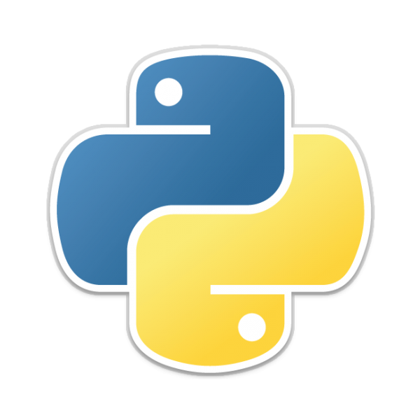
Programming language
It would be unrealistic to communicate using binary
This is where a programming language comes in
One of the key functions of a programming language is to convert natural language instructions into binary code that can be executed by a computer. It also does the reverse!
There are tens of thousands of programming languages out there so which one do we choose?
We pick PYTHON!
This Photo by Unknown Author is licensed under CC BY-SA

Slide 7

Overview of Python

Slide 8
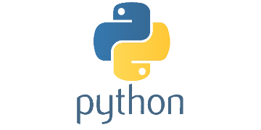
What is Python?
Python is a high-level, interpreted programming language created by Guido van Rossum and first released in 1991. It is known for its readability, simplicity, and versatility, making it an excellent choice for both beginners and experienced programmers.
Fun Fact: Experts or Enthusiast of Python are called Pythonistas

Slide 9
Brief history of python
Guido van Rossum began developing Python in late 1989 as a successor to the ABC language.
The first official release, Python 1.0, came out in January 1994, featuring exception handling, functions, and various core data types.
Python 2.0 was released in October 2000, introducing list comprehensions and a garbage collection system.
Python 3.0, a significant update with backward-incompatible changes, was released in December 2008. It aimed to fix some of the design flaws in Python 2 and improve the language's consistency.
Since then, Python has continued to evolve with regular updates, and Python 3.x has become the standard version used by most developers.

Slide 10
Advantages of Python
Easy to learn and read: Python has a clear, intuitive syntax that emphasizes readability, making it easier for beginners to learn and understand.
Versatile and powerful: Python is a general-purpose programming language that can be used for various tasks, including web development, data analysis, artificial intelligence, and more.
Large community and extensive libraries: Python has a vast and active community that contributes to its extensive library ecosystem. These libraries make it easy to implement complex tasks with just a few lines of code.
Cross-platform compatibility: Python is available on multiple platforms, including Windows, macOS, and Linux, making it easy to develop and run applications across different operating systems.
Strong support for integration: Python can easily integrate with other languages, such as C, C++, and Java, and can interact with various data formats and databases.
Efficient development: Python's simplicity and availability of libraries help developers create applications quickly, reducing development time.

Slide 11

Setting up the environment

Slide 12
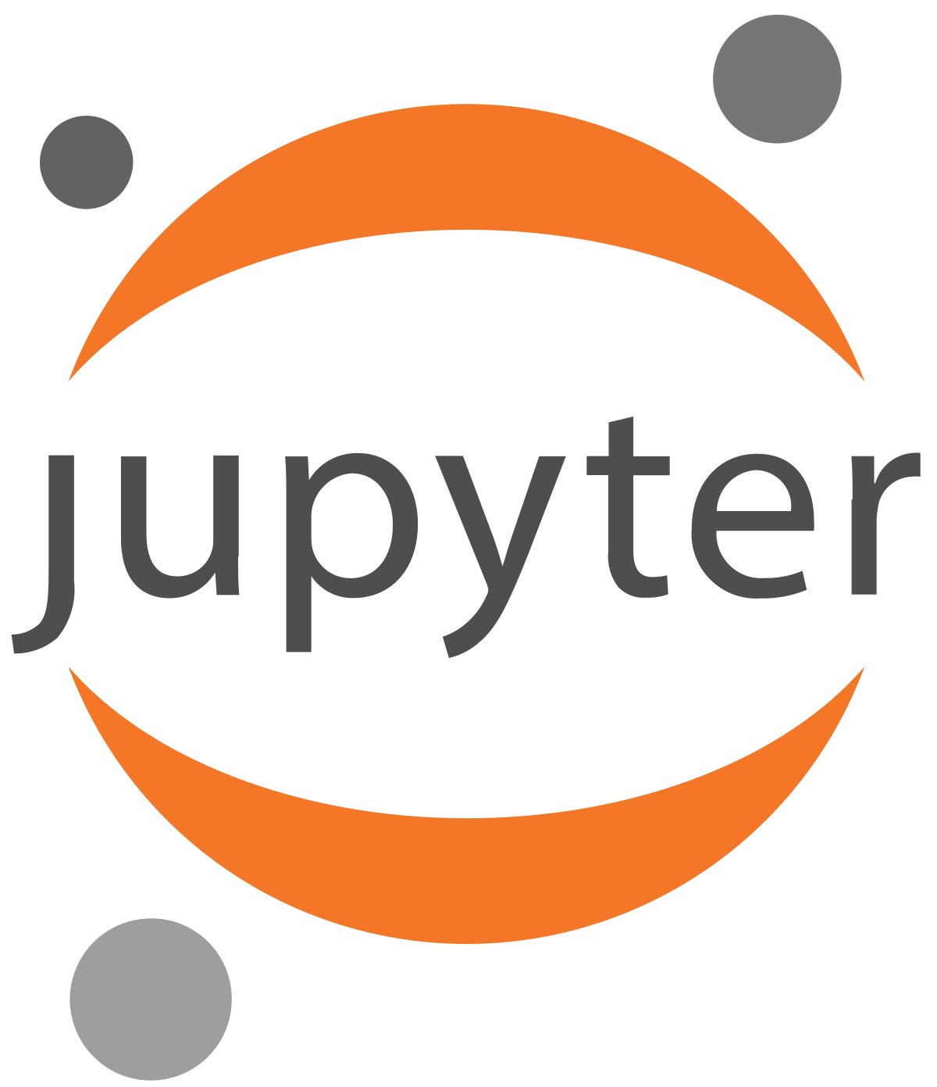

Selecting a Python environment
There are several development environments you can use for Python.
Visual Studio Code
MU
PyCharm
RStudio
Spyder
Google Collab
For the purpose of this course we will use the Jupyter notebooks using google Collab

Slide 13
Jupyter notebook
An open-source web application that allows users to create and share documents containing live code, equations, visualizations, and narrative text.
It is a popular tool for working with data science tools and technologies, such as Python, R, and Julia.
One of the key benefits of Jupyter Notebook is its interactivity. Users can modify the code and see the results immediately, allowing for iterative development and experimentation.
Jupiter Notebook allows for easy sharing and collaboration, as notebooks can be saved and shared as files, or uploaded to services such as GitHub or Google Collab.
Jupyter Notebook supports a wide range of data science tools and technologies, including popular libraries such as NumPy, Pandas, and Matplotlib for data manipulation and visualization, as well as machine learning frameworks such as TensorFlow and PyTorch.

Slide 14
Introduction to Google Colab
Colaboratory (Colab for short) is a data analysis and machine learning tool that allows you to combine executable Python code and rich text along with charts, images, HTML, LaTeX and more into a single document stored in Google Drive. It connects to powerful Google Cloud Platform servers and enables you to easily share your work and collaborate with others.

Slide 15
Google Colab Layout

Slide 16
Introduction to Python programming
The print() statement
Python Data types
The type() function
Variables
Arithmetic operators & expressions
Boolean expressions
The input() function

Slide 17
The print statement
The print statement is a built-function used to display output on the console. It can be used to print a message (i.e., text), a value (i.e., number) or a combination of both.
print("Hello World")
The command above displays the text "Hello, World!" in the console.
print(25)
The command above displays the value 25 in the console

Slide 18
Data Types
In programming, data is a fundamental concept. Data types define the type of data that can be stored in a variable. Understanding data types is critical for writing correct and efficient Python programs. In Python, there are four main data types that you can work with:
Integers
Floats
Strings
Booleans

Slide 19
Integers
Integers are whole numbers with no decimal points.
They can be positive or negative.
In Python, integers are represented using the 'int' data type. For example, 5, -10, and 0 are all integers.
You can perform arithmetic operations on integers, such as addition, subtraction, multiplication and many more.
Examples of integers are: 5, 10, -60, 31

Slide 20
Floats
Floats, also called floating points, are decimal numbers.
They can be positive or negative.
In Python, floats are represented using the 'float' data type.
For example, 3.14, -2.5, and 0.0 are all floats. You can perform arithmetic operations on floats, just like with integers.
Examples of floats are: 3.14, 5.0, 6.9, -27.5

Slide 21
Strings
Strings are sequences of characters.
They can contain letters, numbers, and symbols.
In Python, strings are represented using the 'str' data type.
You can create a string by enclosing characters in single or double quotes.
For example, "hello", 'world', and "123" are all strings.
You can perform string concatenation and indexing operations on strings.
Careful! Be consistent with type of quotes you use. If you use single quotes to start a string, then use single quotes to close the string.

Slide 22
Boolean
Booleans are values that can be either True or False.
In Python, Booleans are represented using the 'bool' data type.
For example, True and False are Booleans.
Booleans are often used in control structure, such as if statements and loops, to determine which code to execute.

Slide 23
The type() function
The type() function is a built-in Python function that allows you to determine the type of an object. It takes an object as its argument and returns the type of the object.
The syntax of the type function,
type(value)
For example,
print(type(5)) # <class 'int'>
print(type(3.14)) # <class 'float'>
print(type("hello")) # <class 'str'>
print(type(True)) # <class 'bool'>

Slide 24
Variables
A variable is a named place in the memory where a programmer can store data and later retrieve the data using the variable “name”
Variables have a name and a value
To assign a value to a variable you use the assign operator "="
For example, let's say we want to store the value of 25 to the variable age. You can do this by,
age = 25
Computer Memory
Name | Value
age | 25

Slide 25
Exercise A:- Updating variable values
When the code is run. The computer memory is empty and there are no outputs.
age = 25
name = "Jamal"
student = True
print(age)
age = 21
name = "Zain"
print(name)
print(student)
Computer Memory
Name | Value
Output

Slide 26
Exercise A:- Updating variable values
We have our first assignment. We will create a variable called age and assign it a value of 25.
age = 25
name = "Jamal"
student = True
print(age)
age = 21
name = "Zain"
print(name)
print(student)
Computer Memory
Name | Value
age | 25
Output

Slide 27
Exercise A:- Updating variable values
Another variable called name is created with a value of “Jamal”
age = 25
name = "Jamal"
student = True
print(age)
age = 21
name = "Zain"
print(name)
print(student)
Computer Memory
Name | Value
age | 25
name | "Jamal"
Output

Slide 28
Exercise A:- Updating variable values
Another variable is created with the name student and value of True.
age = 25
name = "Jamal"
student = True
print(age)
age = 21
name = "Zain"
print(name)
print(student)
Computer Memory
Name | Value
age | 25
name | "Jamal"
student | True
Output

Slide 29
Exercise A:- Updating variable values
We are trying to print the value stored inside the variable age. You can see the value is 25, therefore 25 is printed.
age = 25
name = "Jamal"
student = True
print(age)
age = 21
name = "Zain"
print(name)
print(student)
Computer Memory
Name | Value
age | 25
name | "Jamal"
student | True
Output
>>25

Slide 30
Exercise A:- Updating variable values
We are trying to assign the variable age of 21. Since age already exists, we just overwrite its existing value with the new one
age = 25
name = "Jamal"
student = True
print(age)
age = 21
name = "Zain"
print(name)
print(student)
Computer Memory
Name | Value
age | 21
name | "Jamal"
student | True
Output
>>25

Slide 31
Exercise A:- Updating variable values
The value of name is now updated to “Zain”
age = 25
name = "Jamal"
student = True
print(age)
age = 21
name = "Zain"
print(name)
print(student)
Computer Memory
Name | Value
age | 21
name | "Zain"
student | True
Output
>>25
>>Zain

Slide 32
Exercise A:- Updating variable values
The value stored inside the variable name is outputted.
age = 25
name = "Jamal"
student = True
print(age)
age = 21
name = "Zain"
print(name)
print(student)
Computer Memory
Name | Value
age | 21
name | "Zain"
student | True
Output
>>25
>>Zain

Slide 33
Exercise A:- Updating variable values
The value stored inside the variable student is printed.
age = 25
name = "Jamal"
student = True
print(age)
age = 21
name = "Zain"
print(name)
print(student)
Computer Memory
Name | Value
age | 21
name | "Zain"
student | True
Output
>>25
>>Zain
>>True

Slide 34

Variable naming conventions
There are some rules to follow when naming variables.
Variable names can contain letters, numbers, and underscores. They cannot begin with a number.
Python is a case-sensitive language, so age and Age are considered to be different variable names.
Avoid using reserved keywords as variable names, such as if, while, for, and class.
In addition to these rules, there are some guidelines to be used,
Use descriptive and meaningful names. For example, X0910e is a valid variable name as it doesn't break any of the rules. However, it does not help us understand the value being stored inside the variable.
Avoid using names that are too short or too generic, such as x or temp.
Be consistent in your naming conventions throughout your code.

Slide 35
Arithmetic operators
Operation | Operator | Description | Example | Result
Addition | + | Adds two operands. | 5 + 21 | 26
Subtraction | - | Subtracts the first operand by the second | 9 - 3 | 6
Multiplication | * | Multiplies two operands | 6 * 9 | 54
Division | / | Divides the first operand by the second | 45 / 5 | 9
Floor Division | // | Divides the first operand by the second and rounds down to the nearest integer | 89 // 2 | 44
Modulus | % | Returns the remainder of the division of the first operand by the second | 45 % 2 | 1
Exponentiation | ** | Raises the first operand to the power of the second | 6 ** 2 | 36
Arithmetic operators are used in Python to perform mathematical operations on numeric data types, such as integers and floats. There are several arithmetic operators in Python.

Slide 36

Arithmetic expressions
An expression is a combination of values, variables, and operators that are evaluated to produce a result. In Python, expressions can include arithmetic operations using the arithmetic operators listed in the previous slide.
In Python, arithmetic operators follow a specific order of precedence (PEDMAS). This determines the order in which the operators are evaluated in an expression. The order of precedence is as follows:
Parentheses
Exponentiation (**)
Multiplication (*), Division (/), Floor Division (//), and Modulus (%)
Addition (+) and Subtraction (-)
Let's look at some examples

Slide 37

Exercise:- Arithmetic Expressions
Consider the following problem. The radius of a circle is stored inside a variable called radius. The variable PI contains the value of pi. Write a program to calculate the area of the circle. The value of the Area should be stored in a variable called circle_area. The mathematical relationship between a circle’s radius and the area is shown below.
radius = 25
PI = 3.14
area_circle = ???
print(area)
$$A=πr^{2}$$

Slide 38
Exercise:- Arithmetic Expressions
Consider the following problem. The radius of a circle is stored inside a variable called radius. Write a program to calculate the area of the circle. The value of the Area should be stored in a variable called circle_area. The mathematical relationship between a circle’s radius and the area is shown below.
radius = 25
PI = 3.14
area_circle = PI * (radius ** 2)
print(area)
$$A=πr^{2}$$

Slide 39
Exercise:- Arithmetic Expressions
What do you think the following expressions will equate to?
q1 = 3 + 5 * 2
q2 = 4 / 2 * 3
q3 = 2 + 6 / 2 ** 2
q4 = 10 % 3 + 2 *4
q5 = (5 + 3) * 2 – 4 / 2

Slide 40
Exercise:- Arithmetic Expressions
What do you think the following expressions will equate to?
q1 = 3 + 5 * 2 ==> 13
q2 = 4 / (2 * 3) ==> 6
q3 = 2 + 6 / 2 ** 2 ==> 3.5
q4 = 10 % 3 + 2 * 4 ==> 9
q5 = (5 + 3) * 2 – 4 / 2 ==> 14

Slide 41
Boolean expression
Operation | Operator | Description | Example | Result
Equal to | == | This operator compares two values to see if they are equal. It returns True if the values are equal and False otherwise. | 2 == 2 | True
 |  |  | 3 == 2 | False
Not equal to | != | This operator compares two values to see if they are not equal. It returns True if the values are not equal and False otherwise. | 2 != 2 | False
 |  |  | 3 != 2 | True
Greater than | > | This operator compares two values to see if the first value is greater than the second value. It returns True if the first value is greater and False otherwise. | 6 > 9 | False
 |  |  | 5 > 4 | True
Less than | < | This operator compares two values to see if the first value is less than the second value. It returns True if the first value is less and False otherwise. | 25 < 50 | True
 |  |  | 1 < 0 | False
Greater than or equal to | >= | This operator compares two values to see if the first value is greater than or equal to the second value. It returns True if the first value is greater than or equal and False otherwise. | 3 >= 2 | True
 |  |  | 3 >= 3 | True
Less than or equal to | <= | This operator compares two values to see if the first value is less than or equal to the second value. It returns True if the first value is less than or equal and False otherwise. | 2 <= 3 | True
 |  |  | 3 <= 2 | False
Boolean expressions are expressions that evaluate to a Boolean value, which is either True or False. Boolean expressions are commonly used in programming for making decisions and controlling the flow of code execution.

Slide 42
Combining Boolean expressions
We can combine multiple boolean expressions together using the "and", "or" and "not" logic operators.
The "and" returns True only if all the expressions equate to True
The "or" operator returns True if any one of the expressions equates to True
The "not" operator returns the opposite of the operand's value (i.e. 'True' becomes "False" and vice-versa)
5 > 0 and 10 < 15
5 < 0 and 10 < 15
5 < 0 or 10 < 15
5 < 0 or 10 > 15
not 5 < 0
not 10 > 0

Slide 43
Combining Boolean expressions
We can combine multiple boolean expressions together using the "and", "or" and "not" logic operators.
The "and" returns True only if all the expressions equate to True
The "or" operator returns True if any one of the expressions equates to True
The "not" operator returns the opposite of the operand's value (i.e. 'True' becomes "False" and vice-versa)
5 > 0 and 10 < 15 ➔ True and True
5 < 0 and 10 < 15 ➔ False and True
5 < 0 or 10 < 15 ➔ False or True
5 < 0 or 10 > 15 ➔ False or False
not 5 < 0 ➔ not False
not 10 > 0 ➔ not True

Slide 44
Combining Boolean expressions
We can combine multiple boolean expressions together using the "and", "or" and "not" logic operators.
The "and" returns True only if all the expressions equate to True
The "or" operator returns True if any one of the expressions equates to True
The "not" operator returns the opposite of the operand's value (i.e. 'True' becomes "False" and vice-versa)
5 > 0 and 10 < 15 ➔ True and True ➔ True
5 < 0 and 10 < 15 ➔ False and True ➔ False
5 < 0 or 10 < 15 ➔ False or True ➔ True
5 < 0 or 10 > 15 ➔ False or False ➔ False
not 5 < 0 ➔ not False ➔ True
not 10 > 0 ➔ not True ➔ False

Slide 45
Adding comments
In Python, comments are text that is ignored by the interpreter when running a program. They are used to add explanatory or descriptive notes to the code to make it easier for other programmers (or even yourself in the future) to understand.
Comments in Python start with the # symbol and continue until the end of the line. Any text on that line after the # symbol is treated as a comment and is not executed as part of the program
# This is a comment in Python
print("Hello, World!") # This is also a comment

Slide 46
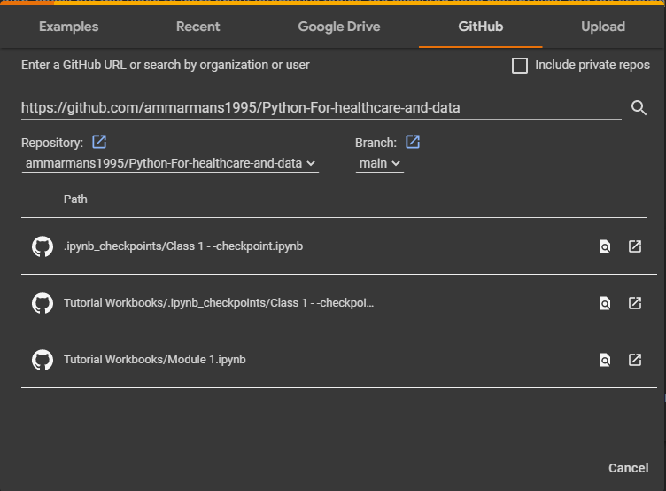
Opening the tutorial
Open Google Colab
https://colab.research.google.com/
Click on File ➔ Upload Notebook ➔ Sign in with your google account
Click on Tutorial Workbooks/ Module 1.ipynb

